Slide 1
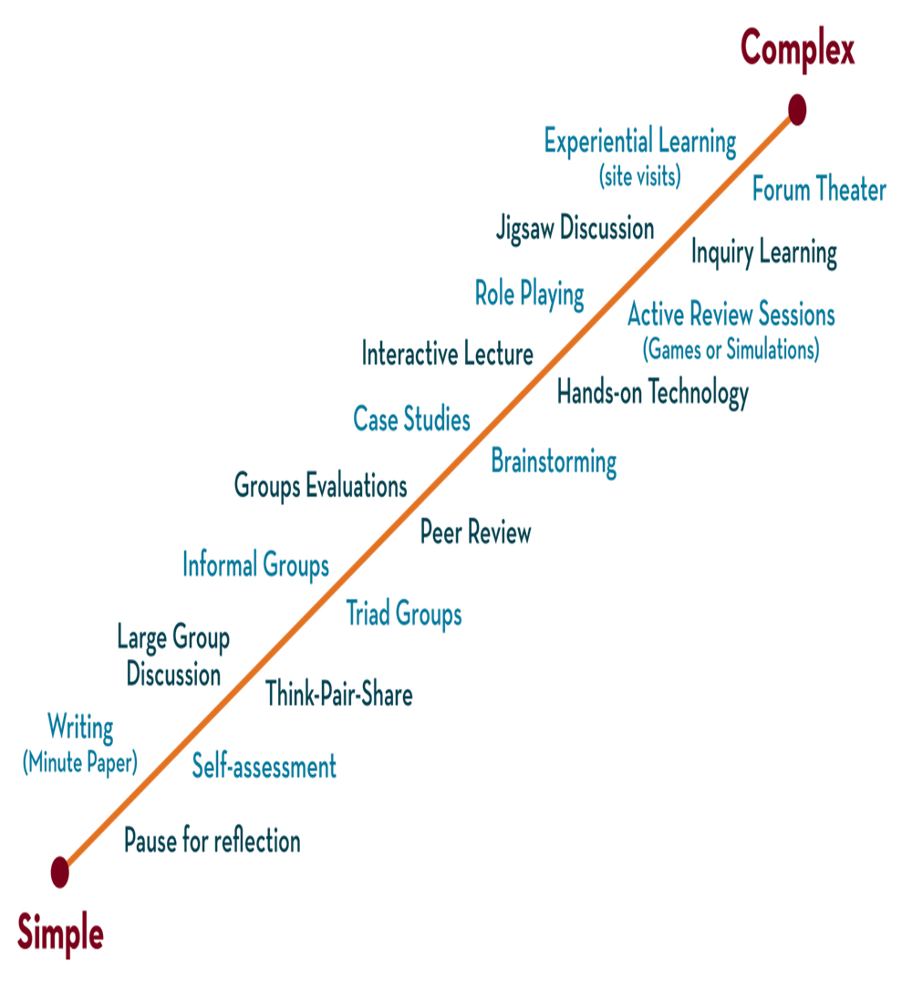

Department of CSE
DESIGN AND ANALYSIS OF ALGORITHMS
24CS2203
Topic:
PRAM Algorithm
Session – 4 & 5

Slide 2





AIM OF THE SESSION
To familiarize students with the concept of Dynamic Programming.
INSTRUCTIONAL OBJECTIVES
This Session is designed to:
Demonstrate :- Dynamic programming and its elements.
Describe :- Steps that the dynamic programming follows.
LEARNING OUTCOMES
At the end of this session, you should be able to:
Define :- Dynamic programming and its elements.
Describe :- Principles of optimality
Summarize:- top-down and bottom-up approaches of dynamic programming.

Slide 3
Introduction
Parallel algorithms are used
Parallel computer
Multiple Processor
Computer
Sequential algorithms are used
Sequential computer
Single Processor

Slide 4
Parallel Algorithms
A parallel algorithm is an algorithm that can execute instructions simultaneously on different processing devices (CPU) & then combine all individual outputs to produce the final result.
They are designed to improve the computation speed of a computer.
To analyze a parallel algorithm, the following parameters are considered
  Time complexity (execution time)
  Total number of processors used
  Total cost

Slide 5
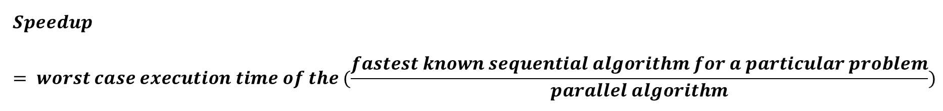
Parallel Algorithms
Time complexity—execution is measured by the time taken by the algorithm to solve a problem.
In parallel computers, if all the processors either do not start or stop execution at the same time, then the total execution time of the algorithm is the moment when the first processor started its execution to the moment when the last processor stops the execution.
Speed of an algorithm – the performance of a parallel algorithm is determined by calculating its speedup.

Slide 6
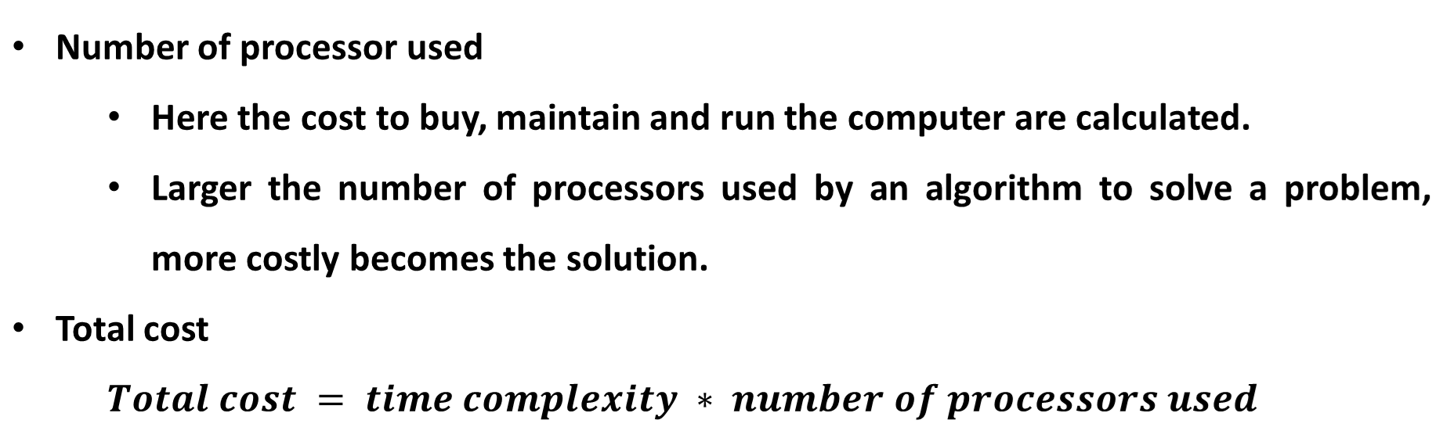
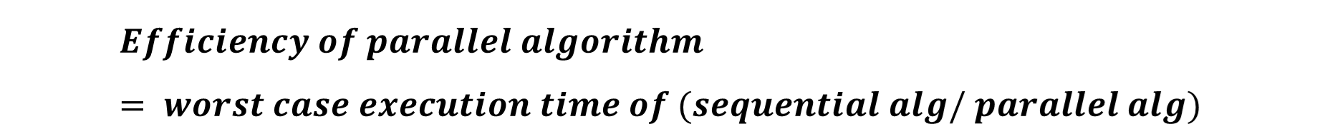
Parallel Algorithms

Slide 7
Parallel Algorithms
To design parallel algorithms, we must first know the model of computations in a parallel computer.
Multi-processing can be defined using Flynn’s classification.
Flynn’s classification in parallel algorithms
  Proposed by Michael J. Flynn in 1966.
  It is based on the multiplicity of instruction streams and data streams in a computer system.

Slide 8
Parallel Algorithms
Instruction stream – it is a sequence of instructions executed by a computer
Data stream – a sequence of data including input data or temporary results.
Based on instructions & data streams, computing systems are classified into 4 major categories
  Single instruction, single data (SISD) systems
  Single instruction, multiple data (SIMD) systems
  Multiple instruction, single data (MISD) systems
  Multiple instruction, multiple data (MIMD) systems

Slide 9
Instructions stream
 | One | Many
One | SISD Single CPU Van Neumann | MISD - Pipelined computer
Many | SIMD Vector processor Parallel computer | MIMD Multi computer Multiprocessors
Data
stream

Slide 10
PRAM Algorithms
Parallel Random-Access Machines (PRAM) algorithms are a central concept in parallel computing, providing a framework for designing and analyzing parallel algorithms.
PRAM is an abstract machine model that assumes multiple processors operating synchronously in parallel, with a shared memory accessible by all processors.
The primary goal of PRAM algorithms is to leverage parallelism to solve computational problems more efficiently than traditional sequential algorithms.

Slide 11
Benefits of PRAM
PRAM algorithms can serve as a foundation for designing parallel programs targeted at real machines.
The base algorithm can aid in establishing tight and upper complexity bounds for practical implementations.
Assumptions made in the PRAM model for ideal parallelism can guide architecture designers in creating innovative designs.
PRAM algorithms are suitable for modern architectures, such as GPUs.

Slide 12
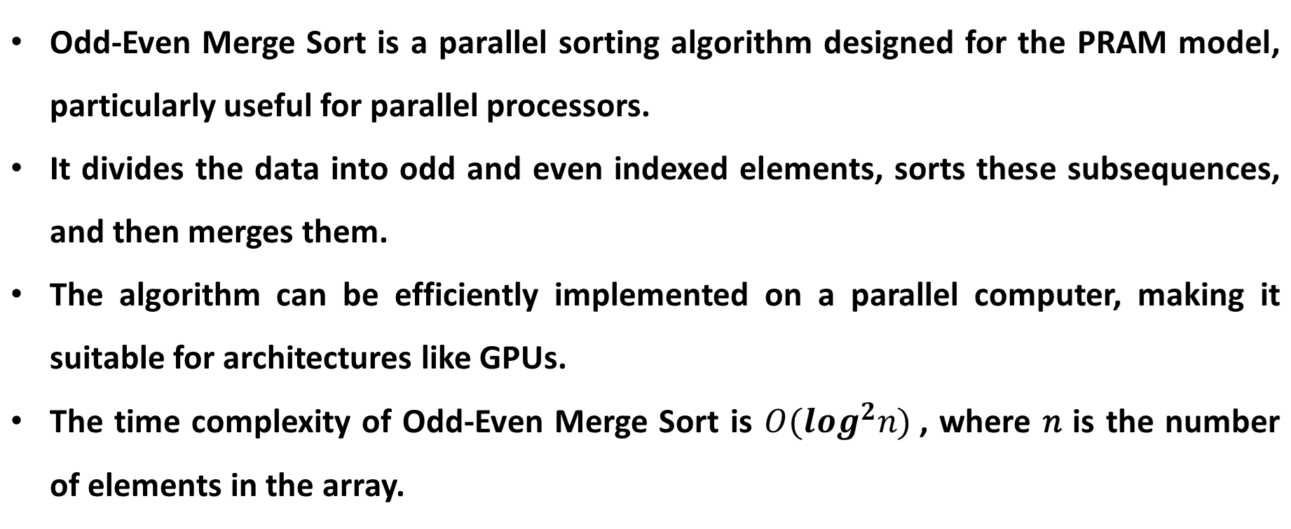
Odd-Even Merge

Slide 13
Odd-Even Merge
Steps:
Divide:
  Split the input array into two sub-arrays: one containing elements at odd indices and the other containing elements at even indices.
Recursively Sort:
  Recursively apply Odd-Even Merge Sort to both sub-arrays until the base case is reached (usually when the sub-array has one element).
Merge:
  Merge the two sorted sub-arrays back together in a sorted manner.

Slide 14
Odd-Even Merge
Merge Process:
Initial Merge:
  Compare and swap elements from the two sorted sub-arrays that have the same relative positions in their respective sub-arrays.
Odd-Even Comparisons:
  Perform a series of comparisons and swaps on odd and even indexed pairs of elements in the combined array until the entire array is sorted.

Slide 15
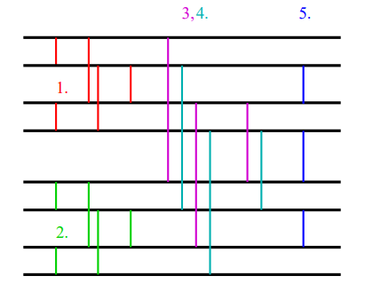
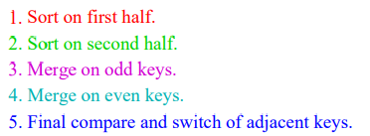
Keys

Slide 16
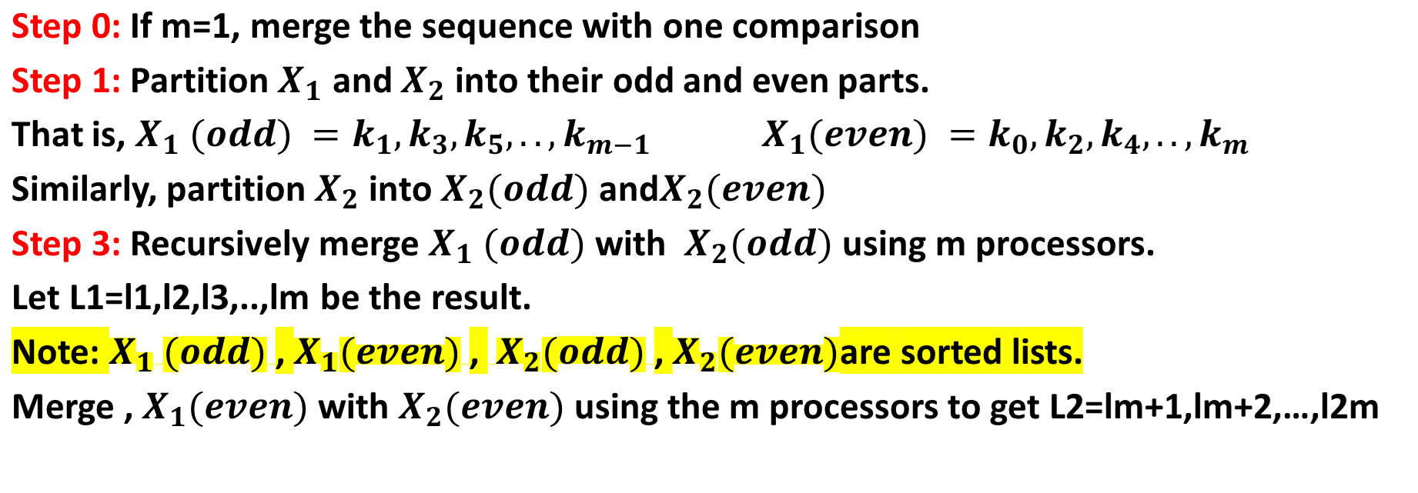
Algorithm

Slide 17
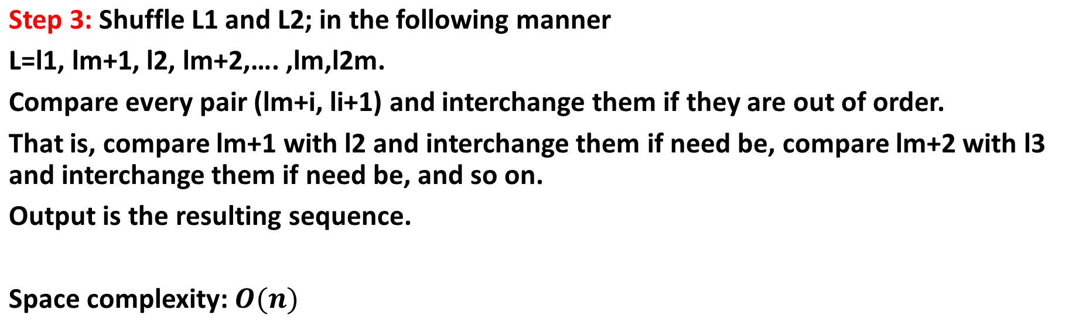
Algorithm

Slide 18
Example
X= 10,7,15,12,5,9,16,20,25,42,39,37,21,14,8,15
X₁’= 10,7,15,12,5,9,16,20 X₂’=25,42,39,37,21,14,8,15
Sort
Sort
5,7,9,10,12,15,16,20
8,14,15,21,25,37,39,42
Odd
Even
Odd
Even
5,9,12,16
7,10,15,20
8,15,25,39
14,21,37,42
Odd merge
Even merge
L1: 5, 8, 9, 12,15,16,25,39
L2 : 7, 10,14,15,20,21,37,42
Shuffle
L : 5, 7,8,10,9,14,12,15,15,20,16,21,25,37,39,42
Compare
5, 7,8,9,10,12,14,15,15,16, 20,21,25,37,39,42

Slide 19
Applications
Odd-Even Merge Sort is particularly useful in applications where parallel processing can be leveraged to sort large datasets quickly, such as:
Sorting in database management systems
Real-time data processing
Parallel computing environments

Slide 20
Home work
Sort the following sequence using the odd-even merge sort algorithm
X={ 4, 6, 3, 17, 14, 11, 2, 34, 7, 5, 12, 45, 21, 19, 11, 32}
X1={2, 8, 11, 13, 14, 18, 21, 29} and X2={3, 6, 11, 15, 16, 20, 23, 31}

Slide 21
int custom_recursive_function (int n)
{
if (n <= 1)
return 1;
else
return 3 * custom_recursive_function (n-1); }
int count = 0;
for (int i = 1; i < n; i = i * 2)
{
for (int j = n; j > 0; j = j / 3)
{
for (int k = 0; k < n; k++)
{
count++;
}
}
}

Slide 22
SUMMARY
Dynamic programming is a technique that breaks the problems into sub-problems and saves the result for future purposes so that we do not need to compute the result again.
The main use of dynamic programming is to solve optimization problems. Here, optimization problems mean that when we are trying to find out the minimum or the maximum solution of a problem.
The dynamic programming guarantees to find the optimal solution of a problem if the solution exists.

Slide 23
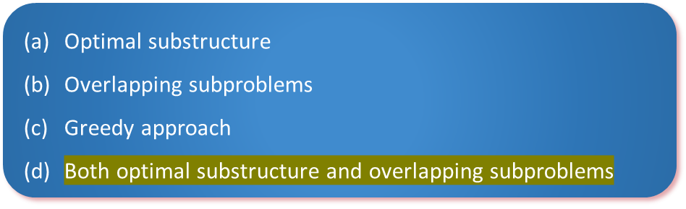
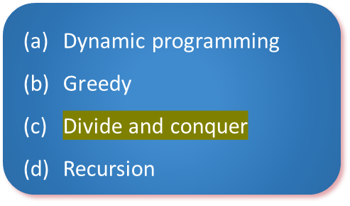
SELF-ASSESSMENT QUESTIONS
1. Which of the following is/are property/properties of a dynamic programming problem?
2. If a problem can be solved by combining optimal solutions to non-overlapping problems, the strategy is called

Slide 24
TERMINAL QUESTIONS
What is the dynamic programming question?
Which problem is solved by dynamic programming?
What are the two methods of dynamic programming?
What are the applications of dynamic programming?
What are the characteristics of dynamic programming?

Slide 25
REFERENCES FOR FURTHER LEARNING OF THE SESSION
Text Books :
1. Ellis Horowitz, Sartaj Sahni and Sanguthevar Rajasekaran, “Fundamentals of ComputerAlgorithms”, 2nd Edition, University Press, 2008.
2. Cormen, Leizerson &Rivest, “Introduction toalgorithms”, 3rd Edition, Prentice-Hall, 2002.
3. Jon Kleinberg and Eva Tardos, “Algorithm Design”,Pearson Education, 2006.
Reference Books :
1. Robert Sedgewick and Kevin wayne , “Algorithms”, 4th edition, Addison WesleyProf.,(2011).
2. Anny Levitin, “Introduction to Design and Analysis of Algorithms”, 2rd Edition, PersonEducation Press. (2007).
3. Michael T.Goodrich and Roberto Tamassia, Algorithm Design: Foundations,Analysis and Internet Examples, Second Edition, Wiley-India, (2006).
4. Steven S. Skiena, “The AlgorithmDesign Manual”, Second Edition, Springer, (2008)
MOOCS :
1. https://www.coursera.org/specializations/algorithms?= 2.https://www.coursera.org/learn/dynamic-programming-greedy-algorithms#modules

Slide 26
THANK YOU

